Slide 1
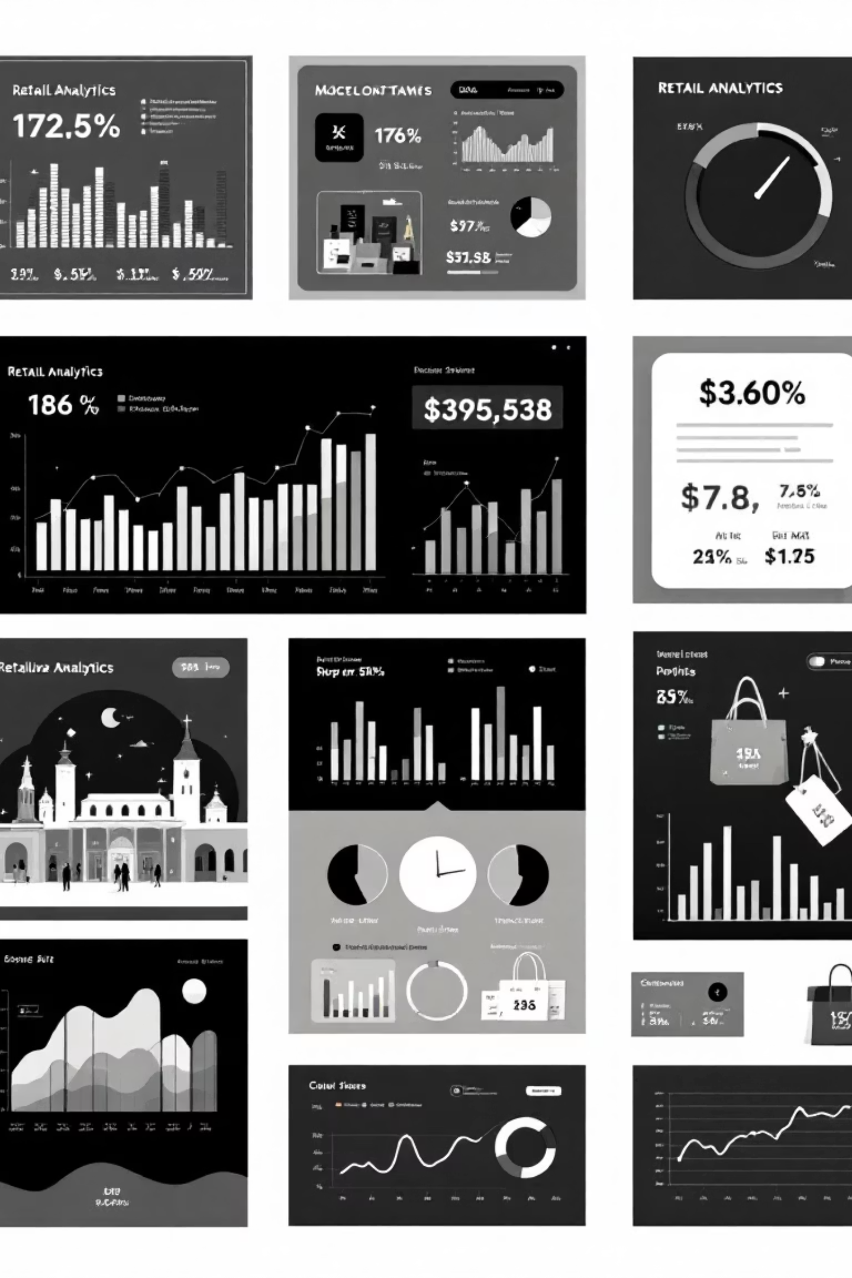
Customer Shopping Behavior Analysis
Uncovering insights from 3,900 purchases to guide strategic business decisions through data-driven analysis of spending patterns, customer segments, and product preferences.

Slide 2
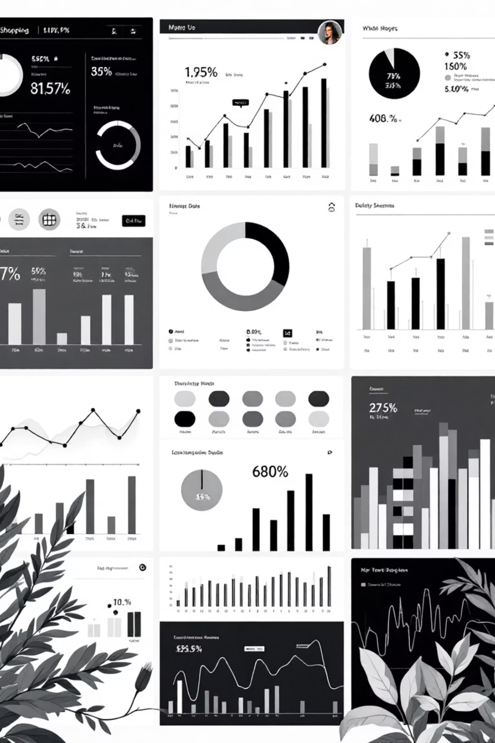
PROJECT SCOPE
Dataset Overview
3,900
18
25
Total Purchases
Data Points
Product Types
Transactions analyzed across all categories
Features tracking demographics and behavior
Unique items across four categories
50
Locations
Geographic distribution of customers

Slide 3

PYTHON ANALYSIS
Data Preparation & Cleaning
01
02
Data Loading & Exploration
Missing Data Handling
Imported dataset using pandas, checked structure with df.info() and summary statistics
Imputed 37 missing Review Rating values using median rating per product category
03
04
Feature Engineering
Database Integration
Created age_group bins and purchase_frequency_days columns for deeper analysis
Connected to MySQL and loaded cleaned DataFrame for SQL business analysis

Slide 4

Key Dataset Statistics
Customer Demographics
Shopping Patterns
Age range: 18-70 years (avg: 44)
Previous purchases: 1-50 (avg: 25)
Gender split: 68% Male, 32% Female
Subscription rate: 27%
Average purchase: $59.76
Discount usage: 43%
Review rating: 3.75/5.0
Top category: Clothing (45%)

Slide 5

SQL INSIGHTS
Revenue Analysis by Gender
Male Customers
Female Customers
$157,890 total revenue
$75,191 total revenue
68% of customer base driving 68% of total revenue
32% of customer base contributing 32% of revenue
Shipping Type Performance
Express shipping: $60.48 average purchase
Standard shipping: $58.46 average purchase
Premium shipping correlates with higher spending

Slide 6
Top-Rated Products
1
2
3
Gloves
Sandals
Boots
Average rating: 3.86/5.0
Average rating: 3.84/5.0
Average rating: 3.82/5.0
4
5
Hat
Skirt
Average rating: 3.80/5.0
Average rating: 3.78/5.0

Slide 7
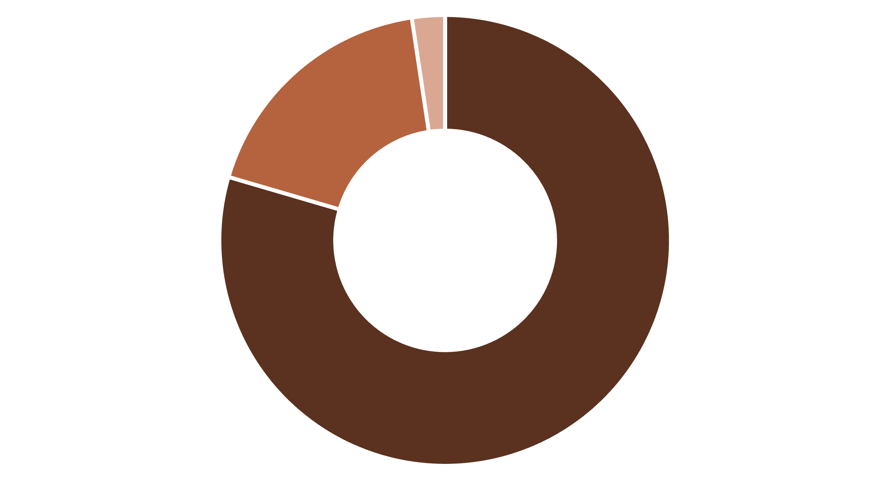
Customer Segmentation Insights
Loyal
Returning
New
Subscription Analysis
Key Finding
Repeat buyers (>5 purchases): 958 subscribers vs. 2,518 non-subscribers
80% of customers are loyal, presenting retention opportunities

Slide 8
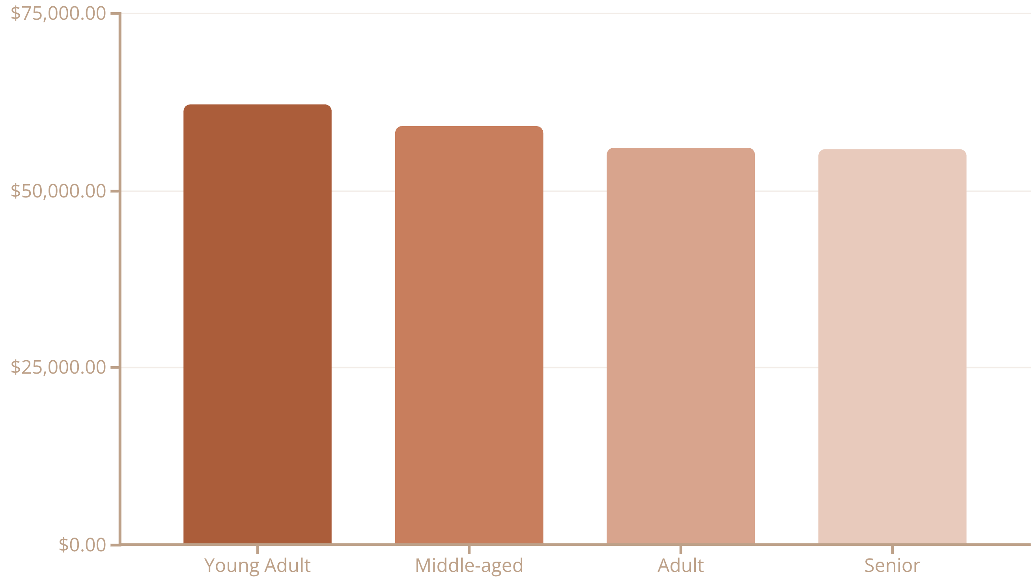
REVENUE BREAKDOWN
Performance by Age Group & Category
Young adults lead revenue generation, followed closely by middle-aged customers. Balanced distribution suggests broad market appeal across demographics.

Slide 9
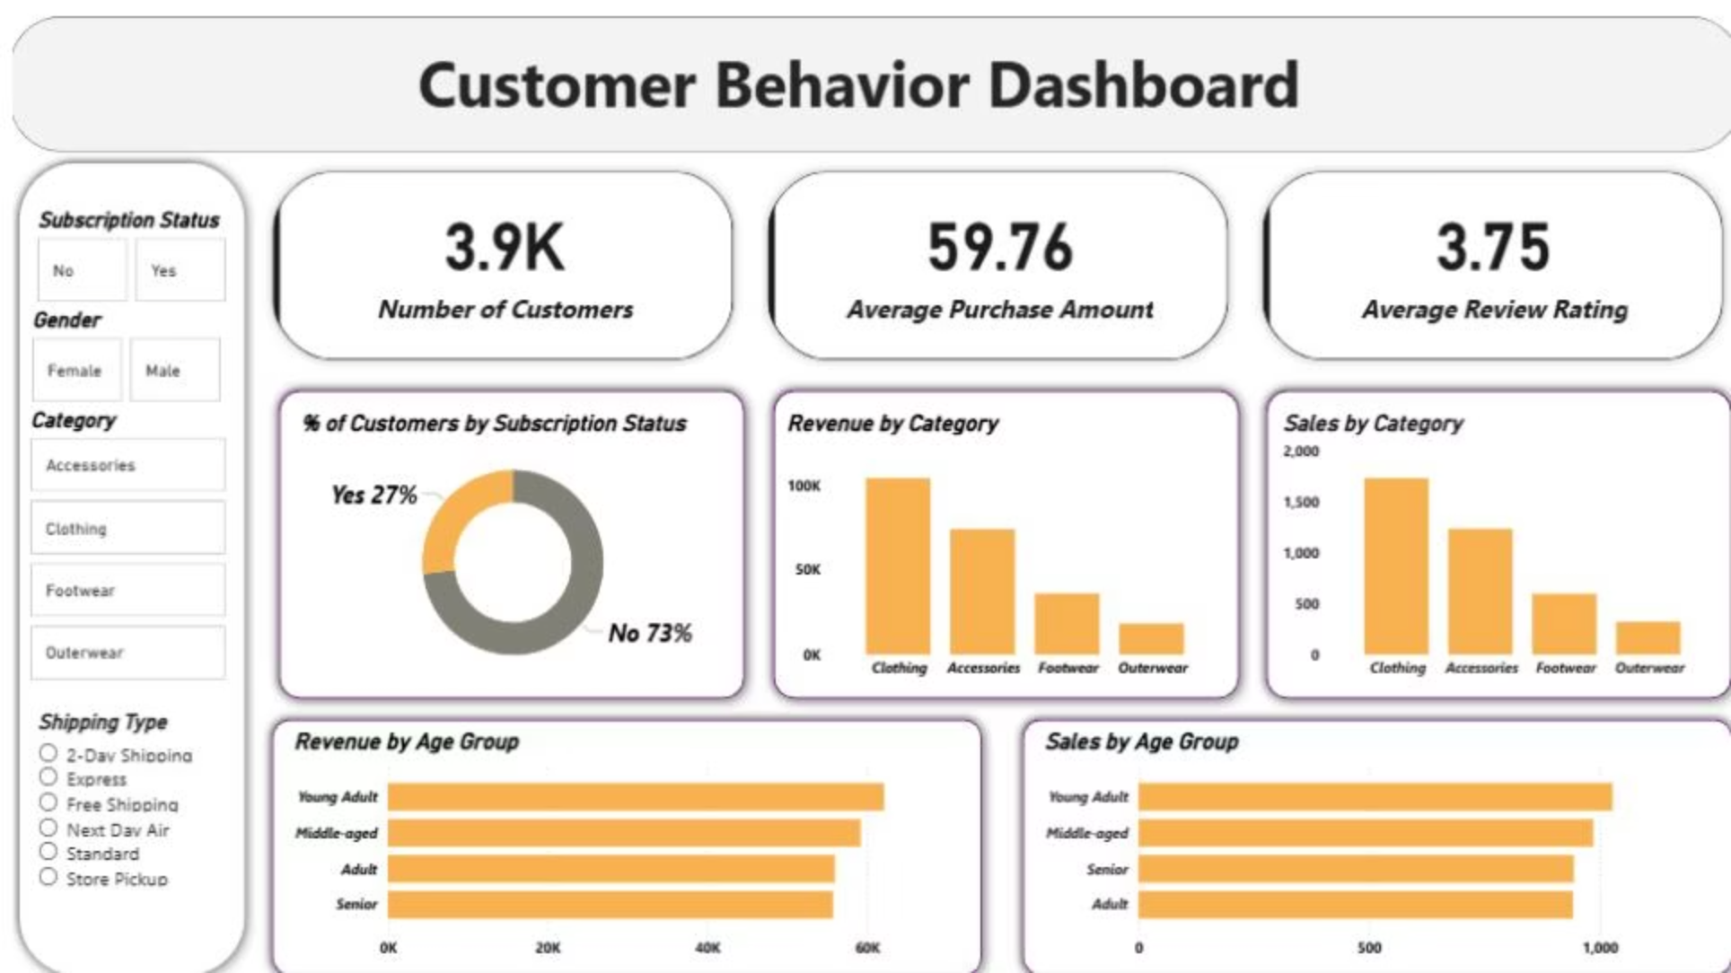



Power BI Dashboard Highlights
73%
45%
43%
Non-Subscribers
Clothing Category
Discount Usage
Significant opportunity for subscription growth
Largest revenue driver at $100K
High discount dependency across products

Slide 10



STRATEGIC RECOMMENDATIONS
Business Action Plan
Boost Subscriptions
Loyalty Programs
Targeted Marketing
Promote exclusive benefits to convert the 73% non-subscriber base
Reward repeat buyers to strengthen the loyal segment
Focus on high-revenue age groups and express-shipping users
Review Discount Policy
Product Positioning
Balance sales boosts with margin control—839 high-spenders used discounts
Highlight top-rated items (Gloves, Sandals, Boots) in marketing campaigns

